Slide 1
Automate CI/CD Pipeline for Node.js Application Deployment
TEAM MEMBERS:
AKASH
BASHAR NAIEEM

Slide 2
INTRODUCTION
Objective: This project will set up a complete CI/CD pipeline to automate the process of building, testing, and deploying a simple Node.js web application to a production server on an AWS EC2 instance.
Key Features:
Automatic deployment upon code changes.
CI/CD pipeline using Jenkins
Hosting on AWS EC2 .

Slide 3
TECHNOLOGIES USED
Version Control: Git, GitHub
CI/CD Tool: Jenkins
Cloud Hosting: AWS EC2
Scripting: Shell scripting
Website: Node.js

Slide 4
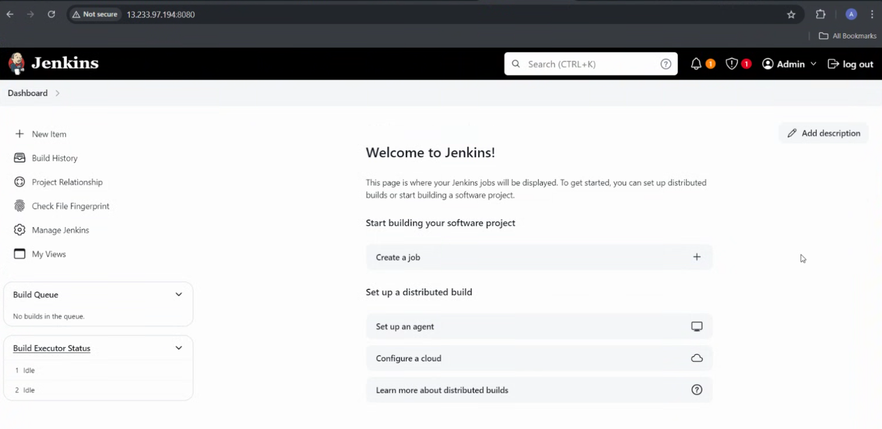
STEP 1: CREATE JENKINS SETUP
1.Create a EC2 instance and install jdk and jenkins.
2.push your Node.js Project to github repo

Slide 5
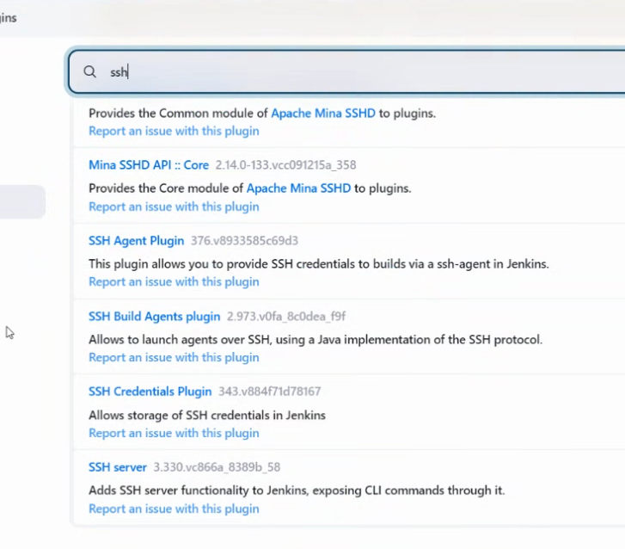
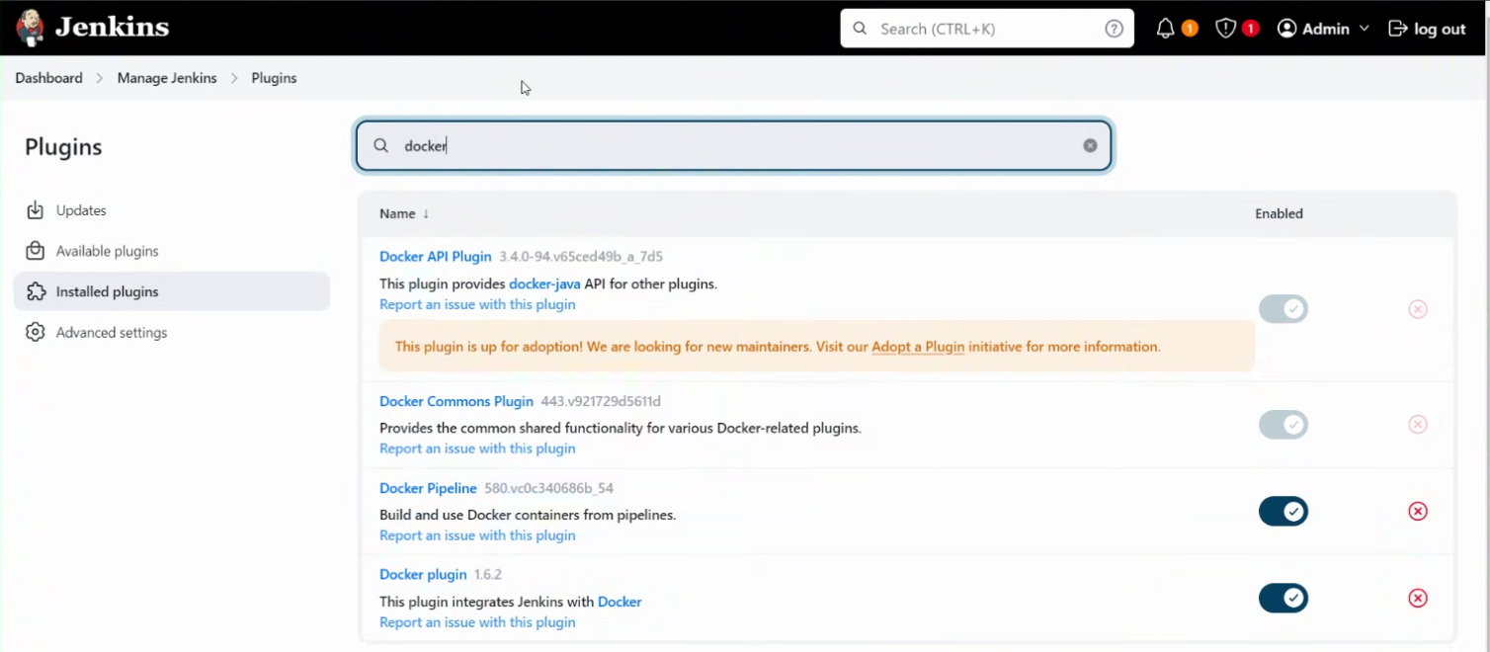
Install required plugins: Git, Docker, SSH Agent.

Slide 6
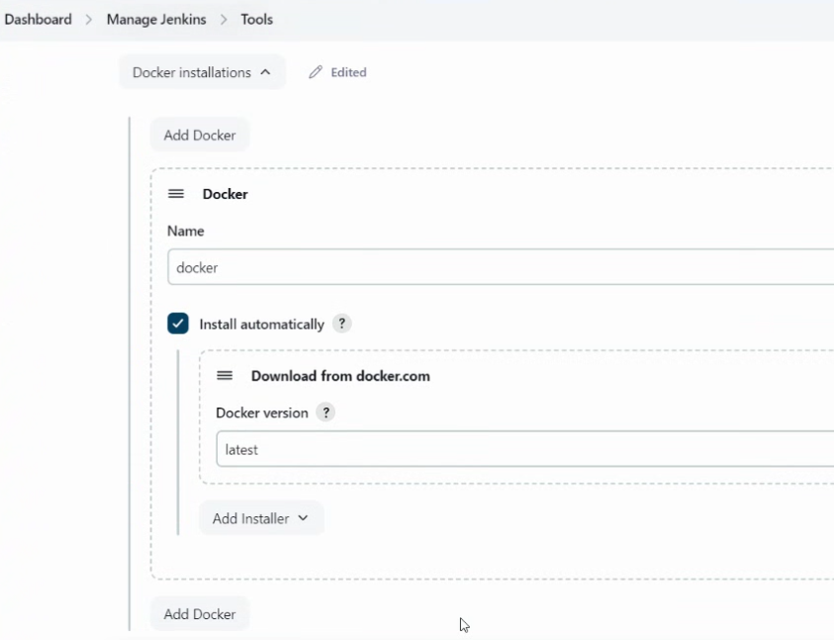
Install Docker in jenkins instance
Manage jenknis -> Tools
->Docker ->Insatll automatically

Slide 7
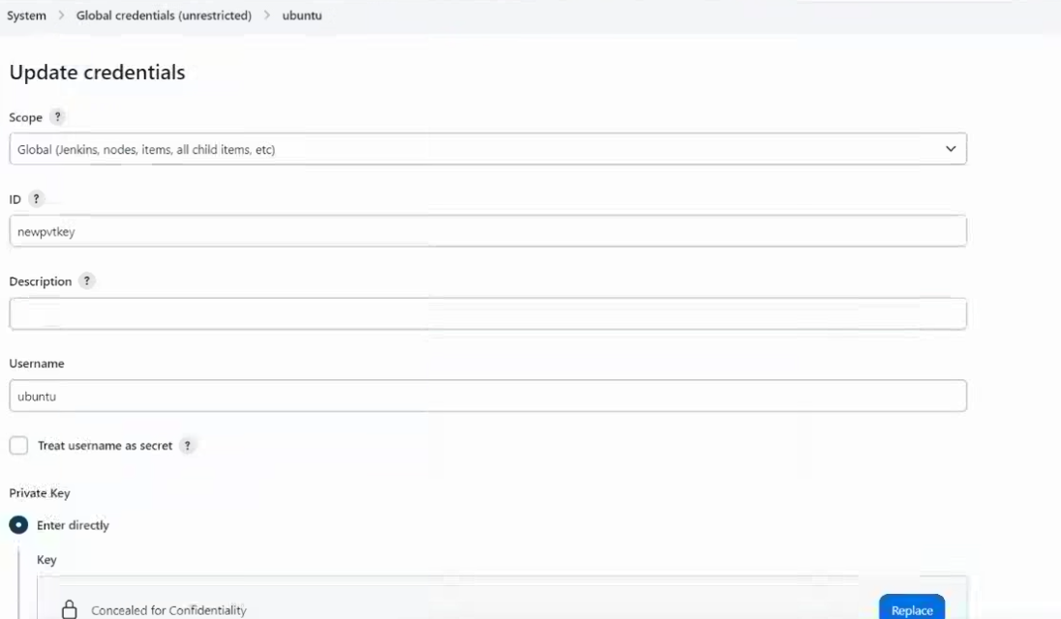
Update the credentials
Manage jenkins -> Credentials
-> give your docker-hub repo credentials to push image to your repo
-> give your private key of your deployment server to host the Node.js application

Slide 8
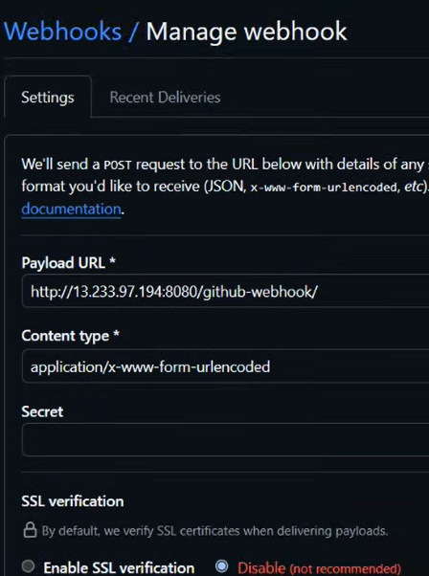
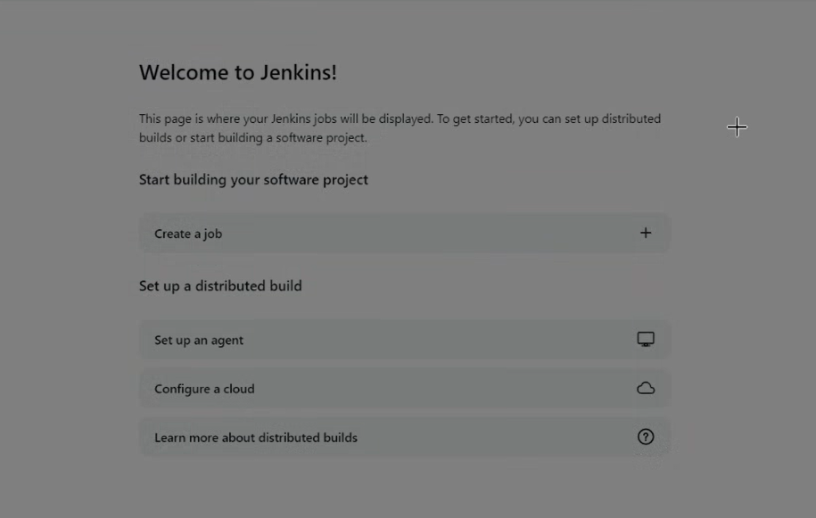
STEP 2: CI/CD PIPELINE SETUP
Add webhook in Gihub repo to update your changes in the deployment also

Slide 9
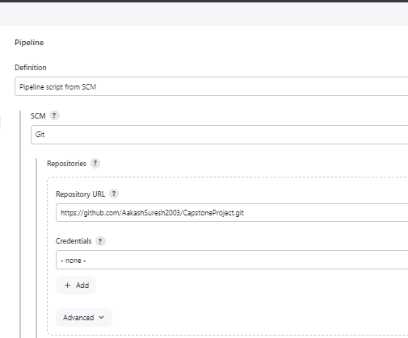
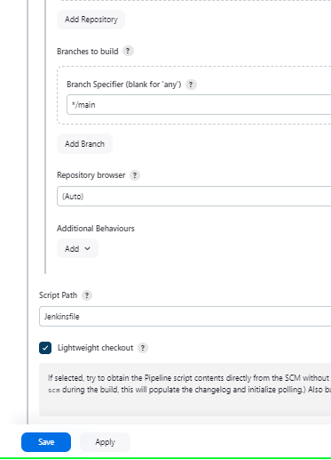

Slide 10
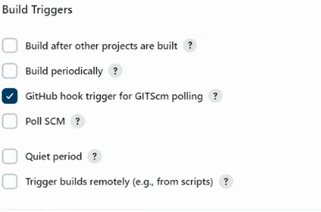
To automate the build process, whenever a new commit is being done in the github repository, configure the Build Triggers >> GitHub hook trigger
Everytime there is an commit to github, the build is auto triggered.
To build the pipeline we need docker file to create image and push to docker repo
and connect to deployment server using ssh and do docker compose
https://github.com/AakashSuresh2003/CapstoneProject.git

Slide 11
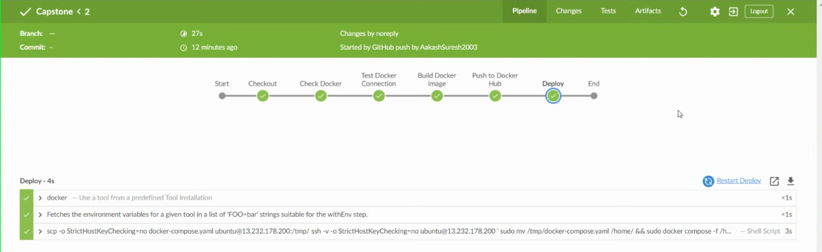
STEP 3: Deployment Completed
https://hub.docker.com/repository/docker/aakashsuresh/node-app/general
https://hub.docker.com/repository/docker/aakashsuresh/node-app/general

Slide 12
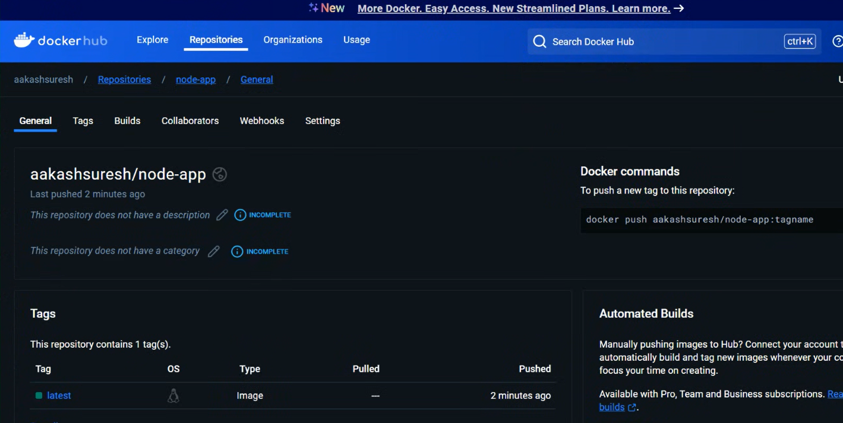

Slide 13
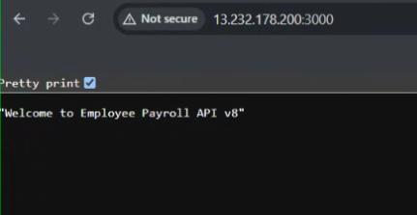
check if the deployment is successful.

Slide 14
THANK YOU!

